Slide 1

AI Coder: Vibe Coder to Agentic Engineer
The Missing Manual
Week 1
Day 2

Slide 2
3 Weeks to Expert Agentic Coder
Core skills
Products / Features
Projects
Week 3: Agentic Engineering as an expert
Multi-Agents
Sub-Agents
Hooks
Sandboxing
Large Codebase
Workflow
Swarms
Orchestrators
Project 4: Capstone
Week 2: Vibe Engineering as a professional
Claude Code
OpenCode
others
Commands
Checkpoints
Ralph Loops
MCP
Skills
Plugins
Workflows
Team
Debugging
Project 3: SaaS Platform
Week 1: Vibe Coding for fun and profit
Agentic Coding Landscape
Foundations
AGENTS.md
Context
Cursor
Copilot, Codex
Antigravity
Project 1: YOLO
Project 2: Commercial MVP

Slide 3


You probably know this well but
Just so we’re on the same page:
LLM
AI Application
Predicts most likely text to follow an input
It’s a pattern matcher that uses statistics based on vast training datasets
The input is a sequence of tokens and output is probability of next token
Called repeatedly to generate a token at a time
A product that uses an LLM to achieve a business goal
ChatGPT
Cursor Agent
DuoLingo Max
Atlassian Rovo
…

Slide 4

Fancy autocomplete with tricks
Trick 1: Illusion of memory
I’m Ed
>> Hi Ed
Who am I?
>> I don’t know
I’m Ed
>> Hello Ed
I’m Ed • Hi Ed • Who am I?
>> You’re Ed
Trick 2: Reasoning / Thinking
Toss 2 coins. One of them is heads. What’s the chances the other is tails?
Trick 3: Tools
To use Python code to respond to the next question, just reply: PYTHON: (a python expression here) Question: What's the square root of pi?
>> PYTHON: math.sqrt(math.pi)
Trick 4: The Loop
Step 1: Ask LLM to make progress
Step 2: Test to see if goal is met
Step 3: If not, go to Step 1

Slide 5
And now:
What is an AI Agent?
Sam Altman “AI systems that can do work for you independently”
Early 2025 consensus (Anthropic, Hugging Face, ..) AI systems where an LLM controls the workflow
Late 2025 An Agent runs Tools in a Loop to achieve a goal

Slide 6
Context Engineering
The Output of an LLM is based entirely on its input (aka ‘context’)
Getting this right is everything!
Previously called Prompt Engineering, but as the inputs became more complex, this became Context Engineering
System Prompt: overall framing
Tools: description of capabilities
Memory: resources that persist
Conversation History / Messages
User messages LLM reasoning
LLM replies
Code generated
Tools called
Results of code and tools

Slide 7
Context Engineering
The Output of an LLM is based entirely on its input (aka ‘context’)
Getting this right is everything!
Previously called Prompt Engineering, but as the inputs became more complex, this became Context Engineering
System Prompt: overall framing
Tools: description of capabilities
Memory: resources that persist
AGENTS.md
Conversation History / Messages
User messages LLM reasoning
LLM replies
Code generated
Tools called
Results of code and tools

Slide 8
Context Window
An LLM has a limit to how many tokens it can examine in its input; inputs longer than this will fail
Also, LLM performance can degrade with longer context
Compacting is the process of summarizing the Conversation History to free up space in the context
System Prompt: overall framing
Tools: description of capabilities
Memory: resources that persist
AGENTS.md
Conversation History / Messages
User messages LLM reasoning
LLM replies
Code generated
Tools called
Results of code and tools

Slide 9
Context Window
An LLM has a limit to how many tokens it can examine in its input; inputs longer than this will fail
Also, LLM performance can degrade with longer context
Compacting is the process of summarizing the Conversation History to free up space in the context
System Prompt: overall framing
Tools: description of capabilities
Memory: resources that persist
AGENTS.md
Conversation History / Messages
Summary of earlier messages

Slide 10
AGENTS.md
# Project Summary
## Goals
..
## Success Criteria
..
# Code standards and guidelines
1. Simpler is better - do not overcomplicate
2. Comments only when necessary
3. Be concise, short README, no emojis
4. IMPORTANT: Avoid overly defensive programming; avoid isinstance checks; only manage exceptions when necessary
5. Use uv; ALWAYS `uv run xxx` NEVER `python3 xxx`
A file in Markdown format with natural language instructions for the Agent that get included in the context
Can be in project root, or at any level of subdirectory
Cursor, Codex, Github Copilot use AGENTS.md Claude Code uses CLAUDE.md
Antigravity uses GEMINI.md

Slide 11
AGENTS.md
# Project Summary
## Goals
..
## Success Criteria
..
# Code standards and guidelines
1. Simpler is better - do not overcomplicate
2. Comments only when necessary
3. Be concise, short README, no emojis
4. IMPORTANT: Avoid overly defensive programming; avoid isinstance checks; only manage exceptions when necessary
5. Use uv; ALWAYS `uv run xxx` NEVER `python3 xxx`
2025 PREVAILING WISDOM:
Invest time crafting AGENTS.md
AGENTS.md at multiple levels
Support with supplemental files
Continually rewrite and prune
Often rewrite & reset context
2026 MINDSET:
Let it go
Focus on end goal
More skills
More loops
More agents

Slide 12
Evolution of Workflows
2025 Approaches
Micro- manage, Approve, Frequent resets
Plan, Execute, Review, Test
SDD;
Trust but verify
2026 Approaches
YOLO
Ralph Loops
Multi- agent
swarms,
orchestrate

Slide 13
Which approach is right
Mission critical software, large codebase, highly innovative code
Micro- manage, Approve, Frequent resets
Plan, Execute, Review, Test
SDD;
Trust but verify
MVPs, new build, risk appetite, boilerplate code
YOLO
Ralph Loops
Multi- agent
swarms,
orchestrate
Your job is to deliver code that is proven to work

Slide 14
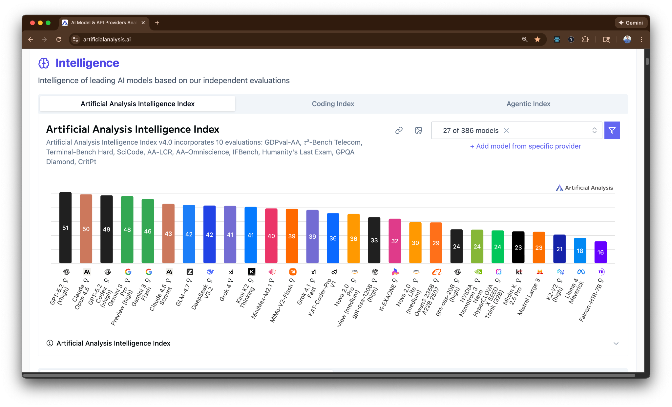
Comparing LLMs

Slide 15
3 Weeks to Expert Agentic Coder
Core skills
Products / Features
Projects
Week 3: Agentic Engineering as an expert
Multi-Agents
Sub-Agents
Hooks
Sandboxing
Large Codebase
Workflow
Swarms
Orchestrators
Project 4: Capstone
Week 2: Vibe Engineering as a professional
Claude Code
OpenCode
others
Commands
Checkpoints
Ralph Loops
MCP
Skills
Plugins
Workflows
Team
Debugging
Project 3: SaaS Platform
Week 1: Vibe Coding for fun and profit
Agentic Coding Landscape
Foundations
AGENTS.md
Context
Cursor
Copilot, Codex
Antigravity
Project 1: YOLO
Project 2: Commercial MVP

Slide 16

AI Coder: Vibe Coder to Agentic Engineer
The Missing Manual
13%
Complete

